Slide 1


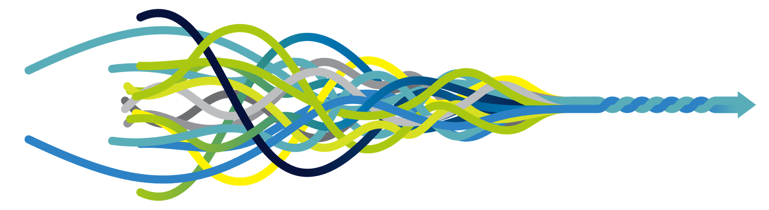
Welcome
Will Dixon
Professor of Digital Epidemiology, University of Manchester &
Honorary Consultant Rheumatologist, Salford Royal Hospital, Northern Care Alliance
Health Research from Home Lead

Slide 2

Opening session
Welcome
Housekeeping
Overview of Health Research from Home
Living with a Long-Term Condition
A view from Government

Slide 3

Housekeeping
Photography – tell HRfH if you object
Don’t leave Major Tom without a chaperone
Whiteboards and post-its
Grant writing retreat
Quote about today’s event
Future annual event
Blue sky thinking: Priorities for HRfH
Networking
Resources
Education
Research

Slide 4

Housekeeping
Photography – tell HRfH if you object
Don’t leave Major Tom without a chaperone
Whiteboards and post-its
Grant writing retreat
Quote about today’s event
Future annual event
Blue sky thinking
No scrolling

Slide 5
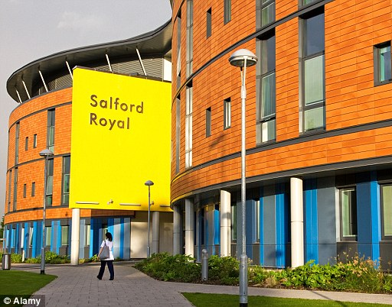


Rheumatologist & Epidemiologist

Slide 6
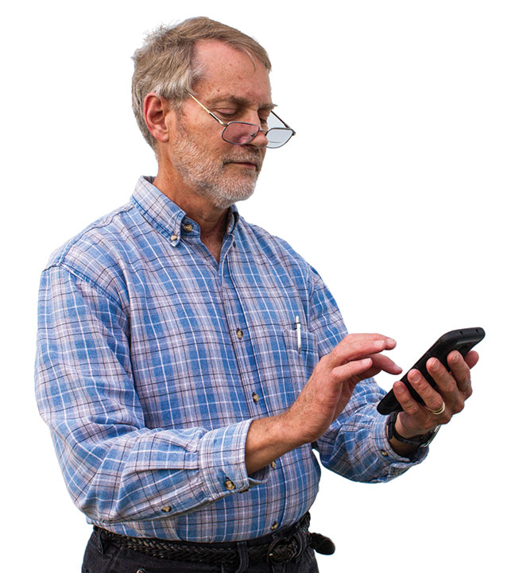
Clinical care
Population health
research
Self-management

Slide 7
The Opportunity
Smartphones and wearables provide global opportunity for the public to participate in relevant, meaningful health research
Novel data collection (tracked symptoms, or measured activity or heart rate) integrated into people’s lives
Time series data – day-to-day changes, measured between clinical visits
Mass participation

Slide 8
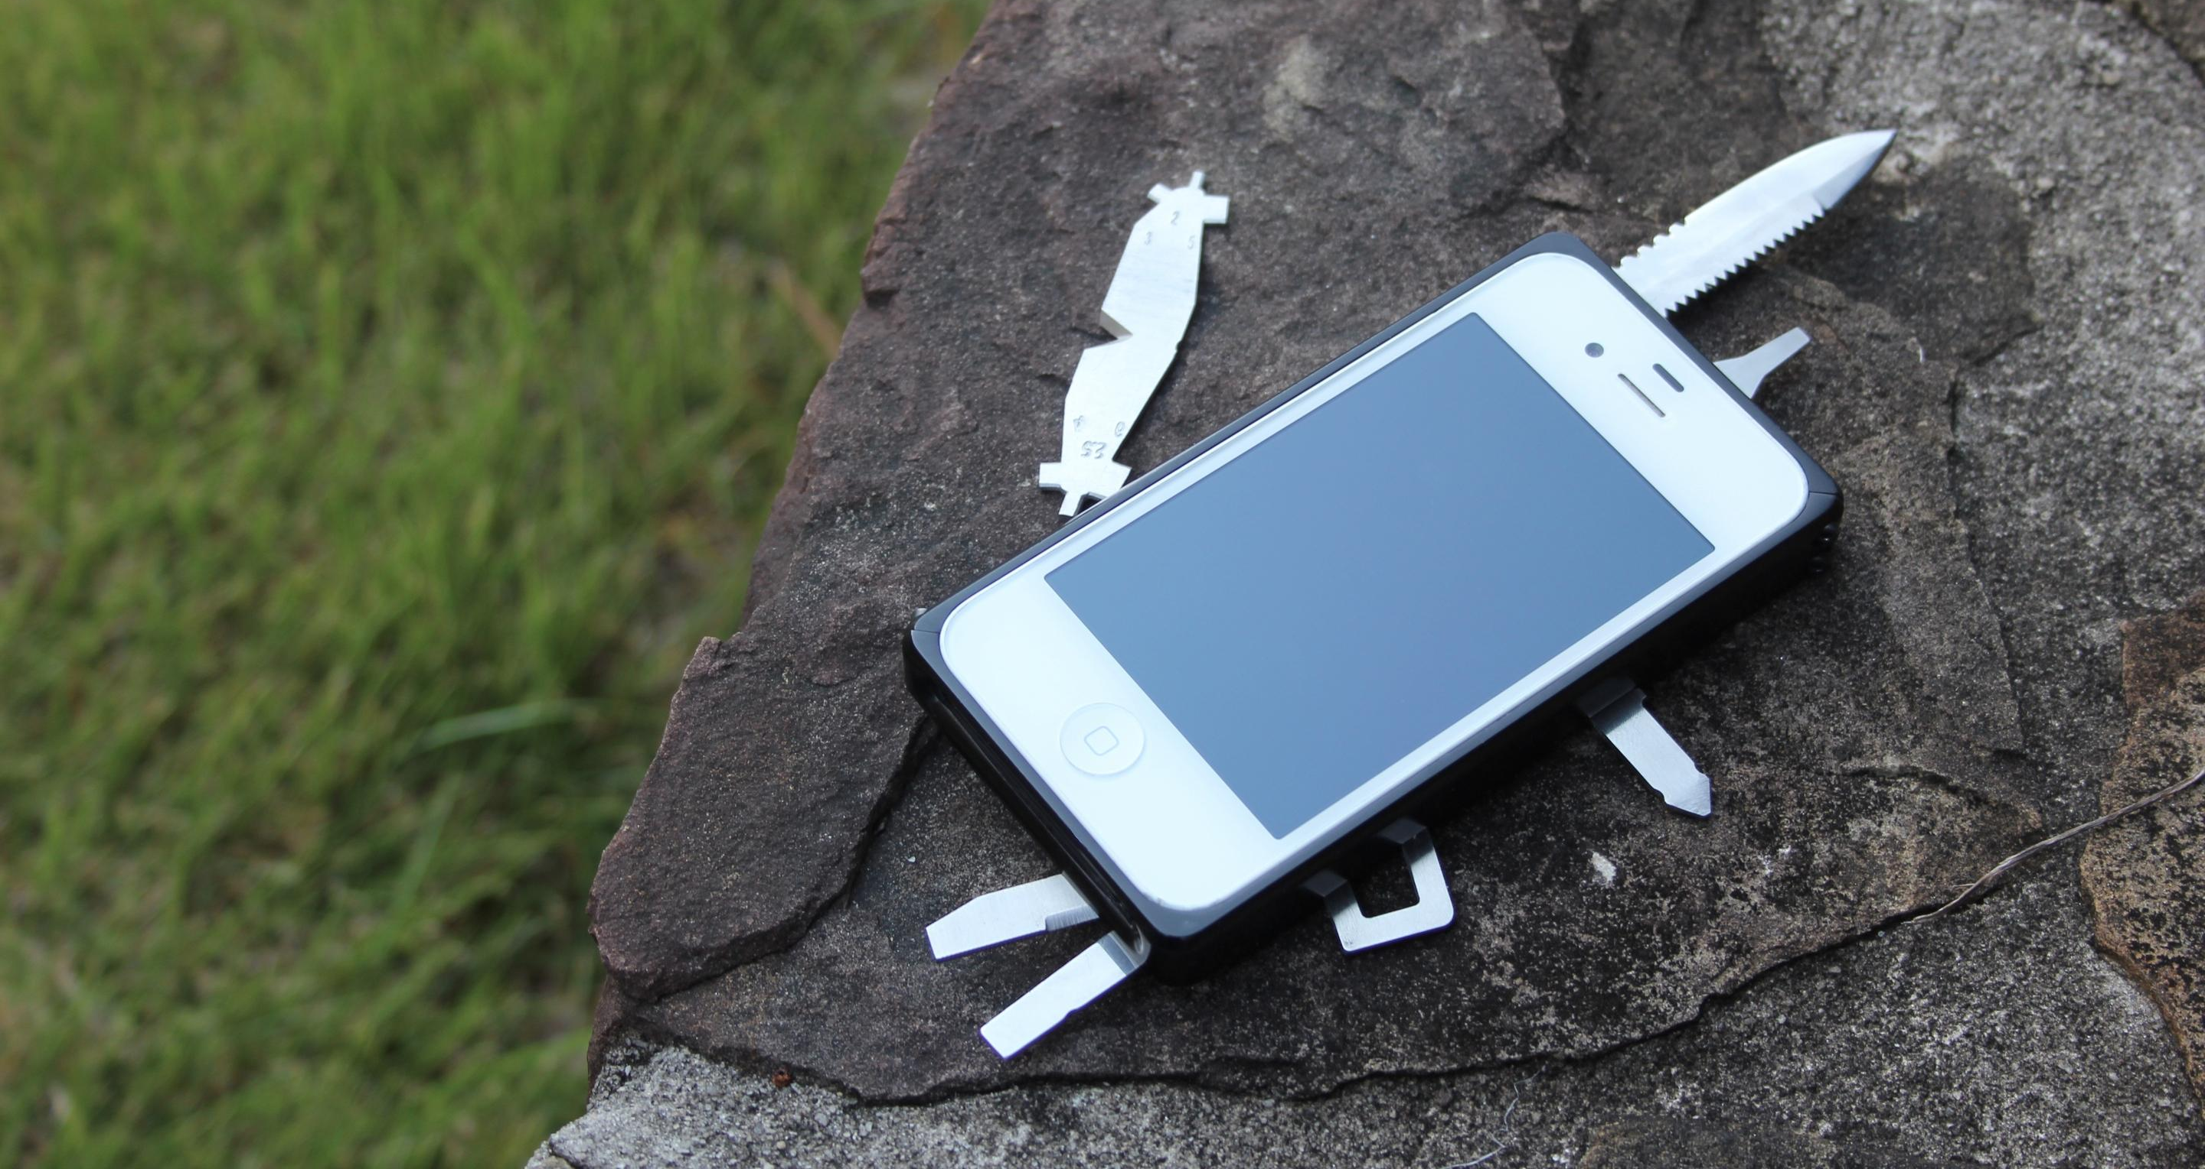
1. Novel data collection
Touch screen
Questionnaires
Smartphone interactions
Accelerometer + gyroscope
Physical activity
Camera
Heart rate, respiratory rate
Video selfies
Microphone
Voice commands
Cough, snore, tremor
GPS
Geolocation

Slide 9
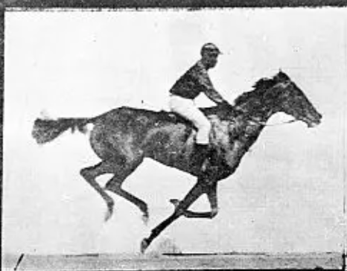
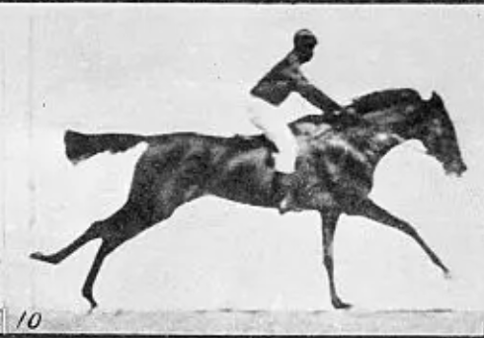
2. Tracking disease through time
?
?
Symptom severity
?
?
Baseline visit
Six month follow-up visit

Slide 10
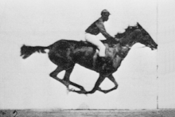
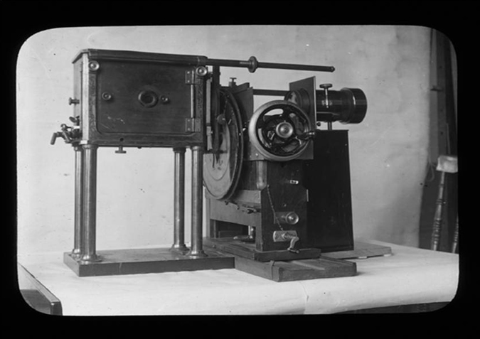
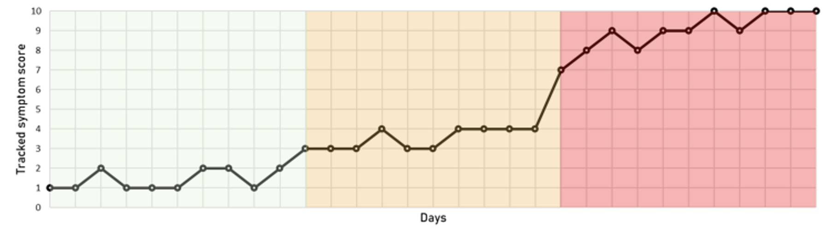
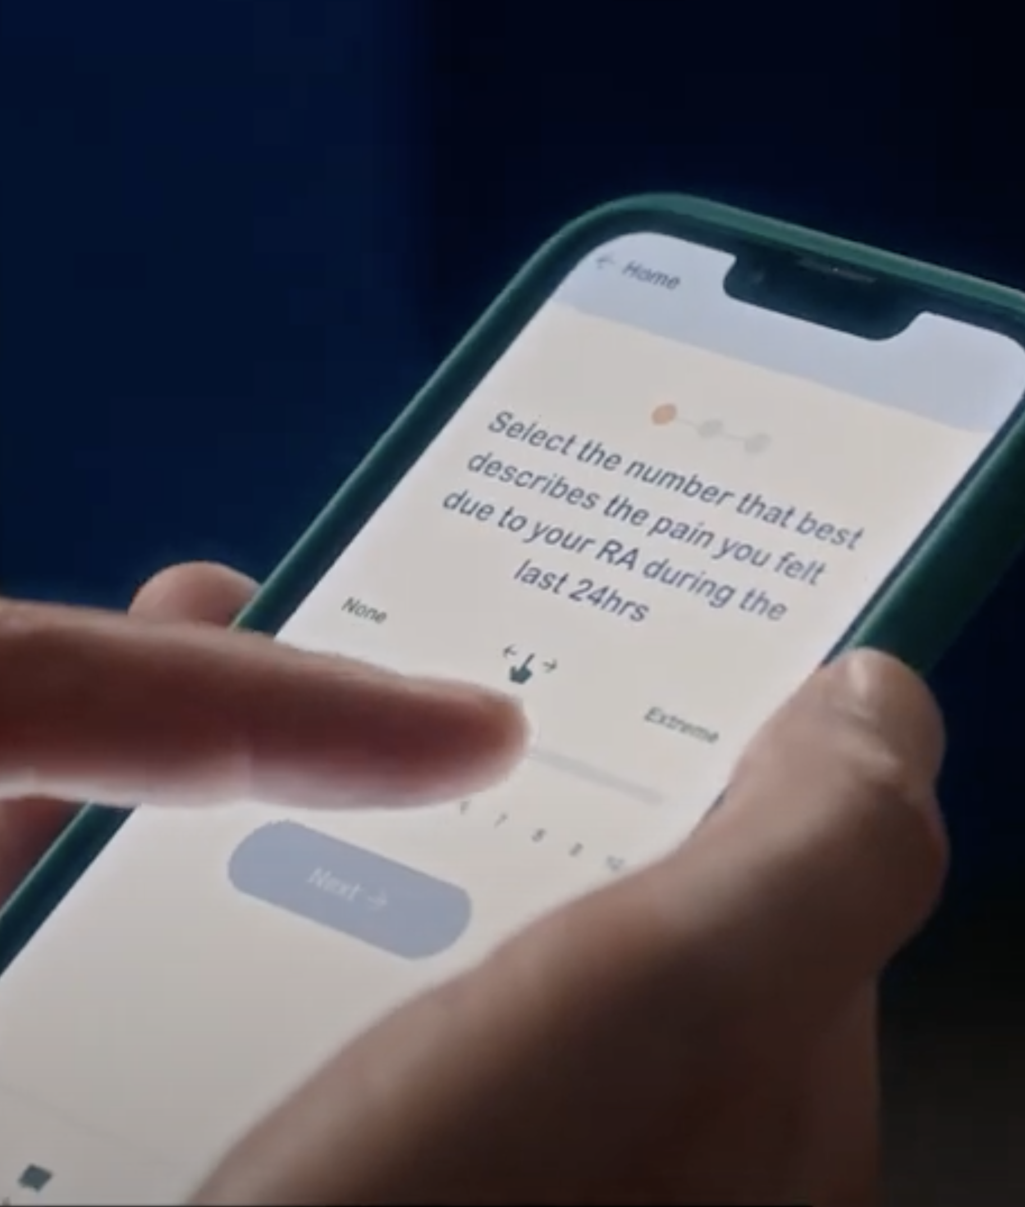
2. Tracking disease through time
With technology
Eadweard Muybridge
Symptom severity
Baseline visit
Six month follow-up visit

Slide 11
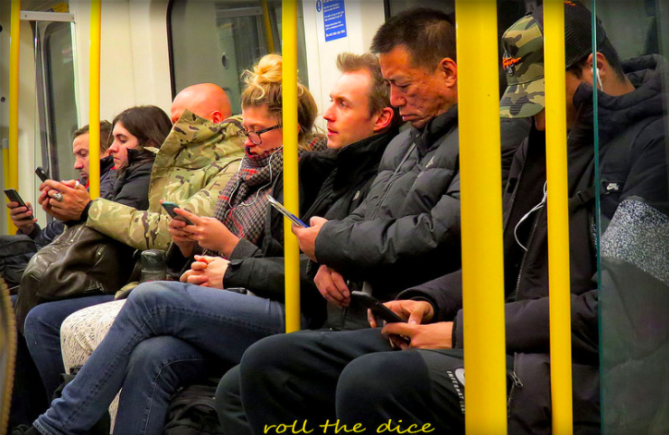
3. Widespread use
Image: Roll the Dice

Slide 12
The Opportunity
Smartphones and wearables provide global opportunity for the public to participate in relevant, meaningful health research*
Novel data collection (tracked symptoms, or measured activity or heart rate) integrated into people’s lives
Time series data – day-to-day changes, measured between clinical visits
Mass participation
* e.g. James Lind Alliance Top 10, Inflammatory Bowel Disease
“What role does diet have in the management of mildly active or inactive ulcerative colitis or Crohn’s Disease to achieve normal daily activities and symptom control”

Slide 13
Background The Challenges
Despite case studies of good success, patient-generated health data (PGHD) research has not delivered at scale because of many challenges
Undervalued importance of patient and public engagement and involvement
Difficult access to data collection tools and platforms
Lack of maturity of optimal study methods/ “best practice”
Gaps in the interdisciplinary teams
“Lack of know-how”

Slide 14
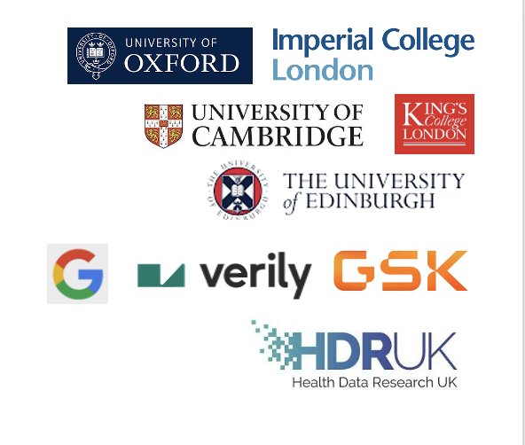
Health Research from Home
MRC Partnership Grant
2024-26
Sharing best practice for using smartphones and wearables for population health research
Getting ‘under the bonnet’ of study conduct

Slide 15



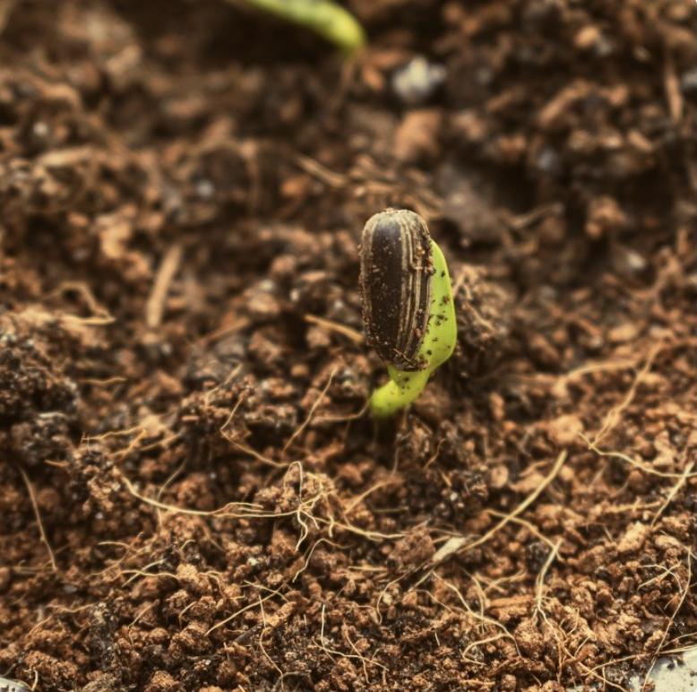
Purpose, vision, mission, values
Our purpose
To improve the lives of people living with long-term conditions
Our vision
To make the UK a world-leader in large-scale, high quality health research using smartphones and wearables, with linkage to national health data assets
Our mission
To build a collaborative community sharing know-how, skills and experience to catalyse and enable future ‘Health Research from Home’
Our values
Creating a cross-sector environment and public partnership where excellent ideas will thrive, inclusive of all perspectives and disciplines

Slide 16
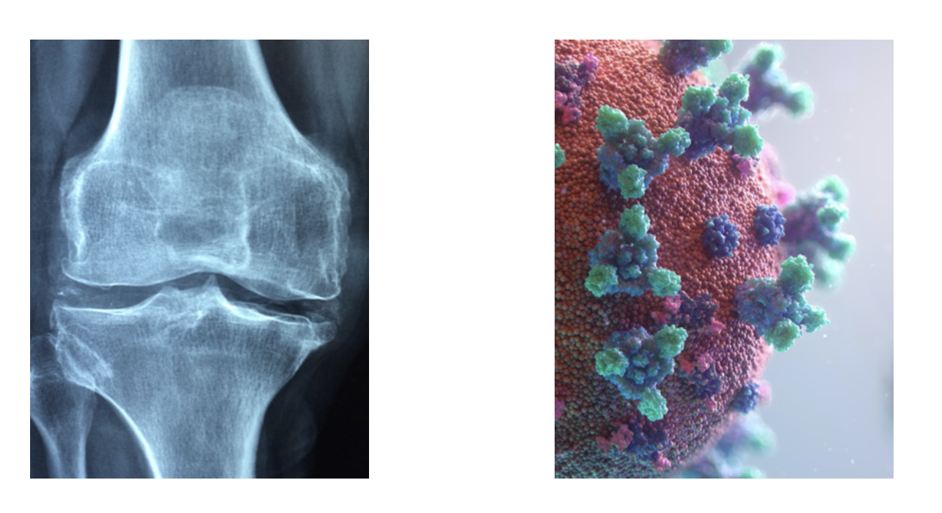

What we do
Events Programme
Repository of resources
Two driver projects, linking person-generated health data to NHS data
PAPrKA
Physical Activity Patterns after
Knee Arthroplasty
Long-term outcomes of COVID

Slide 17
Purpose, vision, mission, values
Our purpose
To improve the lives of people living with long-term conditions
Our vision
To make the UK a world-leader in large-scale, high quality health research using smartphones and wearables, with linkage to national health data assets
Our mission
To build a collaborative community sharing know-how, skills and experience to catalyse and enable future ‘Health Research from Home’
Our values
Creating a cross-sector environment and public partnership where excellent ideas will thrive, inclusive of all perspectives and disciplines

